Slide 1
ECE 551 Digital Design And Synthesis
Spring’ 19
Handy Testbench Constructs:
while, repeat, forever loops
Parallel blocks (fork/join)
Named blocks (disabling of blocks)
Assertions (SV only)
File I/O
Functions & Tasks

Slide 2
Administrative Stuff
Synthesis tutorial Mar. 25th, 26th, & 27th
Monday 6:00 – 7:30 room B555
Tuesday 6:00 – 7:30 room B555
Wednesday 4:00 – 5:30 room B555
HW4 is posted. Due April 3rd

Slide 3
Loops in Verilog
We already saw the for loop:
reg [15:0] rf[0:15]; // memory structure for modeling register file
reg [5:0] w_addr; // address to write to
initial
for (w_addr=0; w_addr<16; w_addr=w_addr+1)
rf[w_addr[3:0]] = 16’h0000; // initialize register file memory
There are 3 other loops available:
While loops
Repeat loop
Forever loop

Slide 4
while loops
Executes until boolean condition is not true
If boolean expression false from beginning it will never execute loop
Handy for cases where loop termination is a more complex function.
Like a search
reg [15:0] flag;
reg [4:0] index;
initial begin
index=0;
found=1’b0;
while ((index<16) && (!found)) begin
if (flag[index]) found = 1’b1;
else index = index + 1;
end
if (!found) $display(“non-zero flag bit not found!”);
else $display(“non-zero flag bit found in position %d”,index);
end
cnv_cmplt
rdy/strt_cnv
WAIT_CNV
cnv_cmplt

Slide 5
repeat Loop
Good for a fixed number of iterations
Repeat count can be a variable but…
It is only evaluated when the loops starts
If it changes during loop execution it won’t change the number of iterations
Used in conjunction with @(posedge clk) it forms a handy & succinct way to wait in testbenches for a fixed number of clocks
initial begin
inc_DAC = 1’b1;
repeat(4095) @(posedge clk); // bring DAC right up to point of rollover
inc_DAC = 1’b0;
inc_smpl = 1’b1;
repeat(7)@(posedge clk); // bring sample count up to 7
inc_smpl = 1’b0;
end

Slide 6
forever loops
We got a glimpse of this already with clock generation in testbenches.
Only a $stop, $finish or a specific disable can end a forever loop.
initial begin
clk = 0;
forever #10 clk = ~ clk;
end
Clock generator is by far the most
common use of a forever loop

Slide 7
System Verilog Support for Random Testing
Sytem verilog has better support for random testing.
class stim_t
rand bit [1:0] func;
rand bit src1sel,src2sel,cin;
rand bit [15:0] instr,RF,mem;
contraint RF_lim {
RF dist {[16’h0001:16’h0003]:=99};
}
endclass
initial begin
stim_t stim = new();
integer x;
for (x=0; x<10; x++) begin
stim.randomize(); // built in method
func = stim.func; // assign stimulus vector
…
end
end

Slide 8
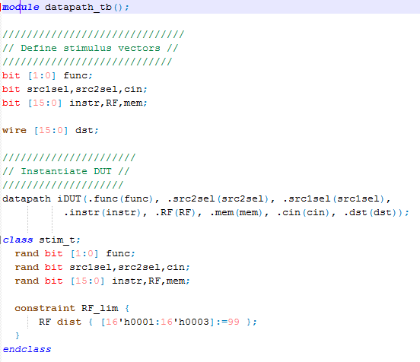
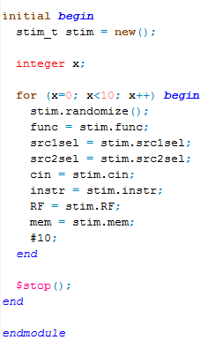
Full Solution

Slide 9
Simulation Example
ModelSim simulation of above system verilog example in class.

Slide 10
Sequential vs Parallel ➔ (begin/end) vs (fork/join)
begin/end are used to form compound sequential statements. We have seen this used many times.
fork/join are used to form compound parallel statements.
Statements in a parallel block are executed simultaneously
All delay or event based control is relative to when the block was entered
begin
fork
@Aevent
@Bevent
join
areg = breg;
end
Can be useful when you want to wait for the occurance of 2 events before flow passes on, but you don’t know the order the 2 events will occur

Slide 11
fork / join (continued)
Can be a source of races
fork
#5 a = b;
#5 b = a;
join
fork
a = #5 b;
b = #5 a;
join
What happens
here?
➔
Fix it like
this
Intra-assignment timing control works because the intra-assignment delay causes the values of a and b to be evaluated before the delay, and the assignments to be made after the delay
fork
#50 r = ’h35;
#100 r = ’hE2;
#150 r = ’h00;
#200 r = ’hF7;
join
What does
this produce?
begin
#50 r = ’h35;
#100 r = ’hE2;
#150 r = ’h00;
#200 r = ’hF7;
end
fork
#200 r = ’hF7;
#150 r = ’h00;
#100 r = ’hE2;
#50 r = ’h35;
join
Compare & contrast to these

Slide 12
Named Blocks
Blocks (begin/end) or (fork/join) can be named
Local variables can be declared for the named block
Variables in a named block can be accessed using hierarchical naming reference
Named blocks can be disabled (i.e. execution stopped)
module top();
initial begin: block1
integer i; // i is local to block1
// top.block1.i
…
end // end of block1
endmodule
block name

Slide 13
disable Statement
Similar to the “break” statement in C
Disables execution of the current block (not permanently)
begin : break
for (i = 0; i < n; i = i+1) begin : continue
@(posedge clk)
if (a == 0) // "continue" loop
disable continue;
if (a == b) // "break" from loop
disable break;
statement1
statement2
end
end
What occurs if (a==0)?
What occurs if (a==b)?
How do they differ?

Slide 14
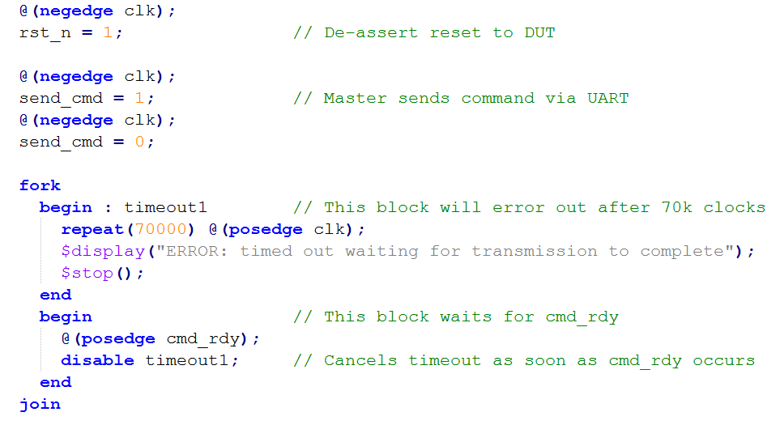
Handy Use of fork/join and disable of a Named Block
A UART master is sending a command to a UART receiver. cmd_rdy will go high when the reception is complete. However, what if cmd_rdy never goes high? Our test bench will freeze. Using fork/join and disable we can make a test bench that will wait for cmd_rdy, but also time out if it never occurs.

Slide 15
Assertions (only in System Verilog)
Self Checking testbenches are a must:
if (result == expected) $display(“self check passed”)
else begin
$display(“ERR: at time %t, result not same as expected”,$time);
$finish();
end
System Verilog offers an assert statement to help simplify this self check.
assert (true_condition) pass_statement
else fail_statement
General Syntax is shown above. Lets look at some examples next.

Slide 16
Assertions (only in System Verilog)
pass_statement
assert (result == expected) $display(“self check passed”)
else $fatal(“ERR: at time %t, result not same as expected”,$time);
fail_statement
$fatal ➔ Throws a fatal message to output, exits the simulator (like a $finish).
$error ➔ Throws a error message to output, continues simulation.
assert (result == expected) $display(“self check passed”)
else begin
$error(“ERR: at time %t, result not same as expected”,$time);
$stop();
end
Either pass or fail statements can be compound statements if you wrap them in begin/end

Slide 17
Assertions…immediate vs concurrent
The examples on the previous slides were “immediate” assertions. The assertion condition is evaluated as the statement is encountered in the test bench flow. They really only offer a better more succinct way of doing a self-check than using an “if” statement.
Another type of assertion available is a “concurrent” assertion. This allows you to define conditions that should always be true, and are checked at all times during simulation i.e. concurrent.
/// check that rd & wrt are never both asserted ///
/// This will be checked at every simulation tick ///
assert property (!(rd && wrt))
else $error(“ERROR: both rd and wrt asserted to SRAM”);
The key word property distinguishes a concurrent assertion from an immediate assertion.
Most concurrent assertions would be checked on clock ticks.

Slide 18
Assertions…concurrent assertions
/// when req is asserted ack should ///
/// be asserted 1 to 2 clocks later ///
assert property (@(posedge clk) req |-> ##[1:2] ack);
The @(posedge clk) specifies the clock associated with this concurrent property. req is actually evaluated just prior to clock rise
The implication operator ( |-> ) had a pre-condition (antecedent sequence) and if that occurs the consequent sequence has to become true.
assert property (@(posedge clk) req |-> ##[1:2] ack);
antecedent
sequence
consequence
sequence
If req is becomes true then ack has to assert within 1 to 2 clock cycles

Slide 19
Assertions…concurrent assertions
The ## operator
A ## followed by a number or range specifies the delay from the current clock tick to the beginning of the sequence that follows.
## is often used with a range. For example: req|-> ##[0:3] gnt would mean gnt should be asserted 0 to 3 clock cycles after req.
Assertions can get rather complex. Don’t have to specify the entire assertion in one line (the directive line)
Might not want to check the assertion during reset.
Can break assertions into multiple parts
sequences
properties
directive

Slide 20
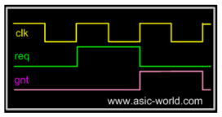
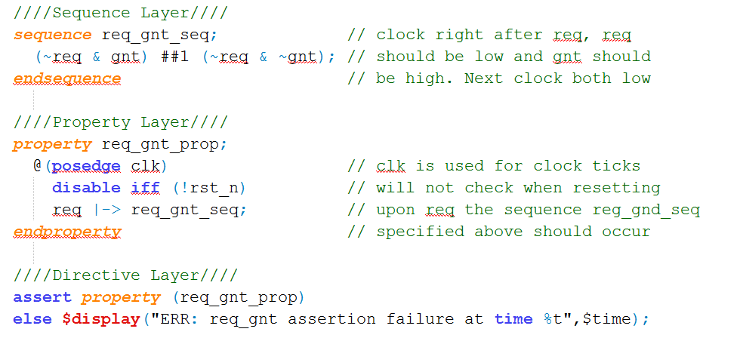
Assertions…concurrent assertions
The waves show the desired behavior. The concurrent assertion example implements it. It breaks the assertion up into a sequence a property, and the final directive.

Slide 21
File I/O – Why?
If we don’t want to hard-code all information in the testbench, we can use input files
Help automate testing
One file with inputs
One file with expected outputs
Can have a software (Python, MatLab, System C) program generate data
Create the inputs for testing
Create “correct” output values for testing
Can use files to “connect” hardware/software system

Slide 22
Opening/Closing Files
$fopen opens a file and returns an integer descriptor
integer fd = $fopen(“filename”);
integer fd = $fopen(“filename”, “r”);
If file cannot be open, returns a 0
Can output to more than one file simultaneously by writing to the OR ( | ) of the relevant file descriptors
Easier to have “summary” and “detailed” results
$fclose closes the file
$fclose(fd);

Slide 23
Writing To Files
Output statements have file equivalents
$fmonitor()
$fdisplay()
$fstrobe()
$fwrite() // write is like a display without the \n
These system calls take the file descriptor as the first argument
$fdisplay(fd, “out=%b in=%b”, out, in);

Slide 24
Reading From Files
Read a binary file: $fread(destination, fd);
Can specify start address & number of locations too
Good luck! I have never used this.
Very rich file manipulation (see IEEE Standard)
$fseek(), $fflush(), $ftell(), $rewind(), …
Will cover a few of the more common read commands next

Slide 25
Using $fgetc to read characters
module file_read()
parameter EOF = -1;
integer file_handle,error,indx;
reg signed [15:0] wide_char;
reg [7:0] mem[0:255];
reg [639:0] err_str;
initial begin
indx=0;
file_handle = $fopen(“text.txt”,”r”);
error = $ferror(file_handle,err_str);
if (error==0) begin
wide_char = 16’h0000;
while (wide_char!=EOF) begin
wide_char = $fgetc(file_handle);
mem[indx] = wide_char[7:0];
$write(“%c”,mem[indx]);
indx = indx + 1;
end
end
else $display(“Can’t open file…”);
$fclose(file_handle);
end
endmodule
The quick brown fox jumped over the lazy dogs
text.txt
When finished the array mem will contain the characters of this file one by one, and the file will have been echoed to the screen.
Why wide_char[15:0] and why signed?

Slide 26
Using $fgets to read lines
module file_read2()
integer file_handle,error,indx,num_bytes_in_line;
reg [256*8:1] mem[0:255],line_buffer;
reg [639:0] err_str;
initial begin
indx=0;
file_handle = $fopen(“text2.txt”,”r”);
error = $ferror(file_handle,err_str);
if (error==0) begin
num_bytes_in_line = $fgets(line_buffer,file_handle);
while (num_bytes_in_line>0) begin
mem[indx] = line_buffer;
$write(“%s”,mem[indx]);
indx = indx + 1;
num_bytes_in_line = $fgets(line_buffer,file_handle);
end
end
else $display(“Could not open file text2.txt”);
$fgets() returns the number of bytes in the line. When this is a
zero you know you hit EOF.

Slide 27
Using $fscanf to read files
module file_read3()
integer file_handle,error,indx,num_matches;
reg [15:0] mem[0:255][0:1];
reg [639:0] err_str;
initial begin
indx=0;
file_handle = $fopen(“text3.txt”,”r”);
error = $ferror(file_handle,err_str);
if (error==0) begin
num_matches = $fscanf(file_handle,”%h %h”,mem[indx][0],mem[indx][1]);
while (num_matches>0) begin
$display(“data is: %h %h”,mem[indx][0],mem[indx[1]);
indx = indx + 1;
num_matches = $fscanf(file_handle,”%h %h”,mem[indx][0],mem[indx][1]);
end
end
else $display(“Could not open file text3.txt”);
12f3 13f3
abcd 1234
3214 21ab
text3.txt

Slide 28
Loading Memory Data From Files
This is very useful (memory modeling & testbenches)
$readmemb(“<file_name>”,<memory>);
$readmemb(“<file_name>”,<memory>,<start_addr>,<finish_addr>);
$readmemh(“<file_name>”,<memory>);
$readmemh(“<file_name>”,<memory>,<start_addr>,<finish_addr>);
$readmemh ➔ Hex data…$readmemb ➔ binary data
But they are reading ASCII files either way (just how numbers are represented)
// addr data
@0000 10100010
@0001 10111001
@0002 00100011
// addr data
@0000 A2
@0001 B9
@0002 23
//data
A2
B9
23
example “binary”
file
example “hex”
file
address is optional for the lazy

Slide 29
Example of $readmemh
module rom(input clk; input [7:0] addr; output [15:0] dout);
reg [15:0] mem[0:255]; // 16-bit wide 256 entry ROM
reg [15:0] dout;
initial
$readmemh(“constants”,mem);
always @(negedge clk) begin
///////////////////////////////////////////////////////////
// ROM presents data on clock low //
/////////////////////////////////////////////////////////
dout <= mem[addr];
end
endmodule

Slide 30
Testbench Example (contrived but valid)
module test_and;
integer file, i, code;
reg a, b, expect, clock;
wire out;
parameter cycle = 20;
and #4 a0(out, a, b); // Circuit under test
initial begin : file_block
clock = 0;
file = $fopen("compare.txt", “r” );
for (i = 0; i < 4; i=i+1) begin
@(posedge clock) // Read stimulus on rising clock
code = $fscanf(file, "%b %b %b\n", a, b, expect);
#(cycle - 1) // Compare just before end of cycle
if (expect !== out)
$strobe("%d %b %b %b %b", $time, a, b, expect, out);
end // for
$fclose(file); $stop;
end // initial
always #(cycle /2) clock = ~clock; // Clock generator
endmodule

Slide 31
Another Testbench Example using File I/O
chnnl[2:0]
Equalizer Digital Core
Class D
Amp
(TPA3112)
SS_n
SCLK
strt_cnv
amp_on
A2D Converter on DE0 Nano
A2D Intf
(SPI based)
From Slide Pots
MOSI
MISO
res[11:0]
Class D
Amp
(TPA3112)
$readmemh
cnv_cmplt
rht_in[15:0]
lft_out[15:0]
LED[7:0]
The analog data that represents the settings of the slide potentiometers is read into the model of the ADC128S (converter on DE0-Nano board) model via a $readmemh command
lft_in[15:0]
valid
rht_out[15:0]
CODEC Interface
expected
results
SCLK
LRCLK
MCLK
$readmemh
RSTn
SDin
SDout
CODEC
MODEL
(CS4272)
Compare
Logic
L_out
R_out
The analog data that represents the music from the headphone jack is modeled as a file read in to the CS4272 model via a $readmemh command
$readmemh
One could imagine having a Python script that read the audio data file, the slide pot setting file, and computed an expected results file for comparison.

Slide 32
functions
Declared and referenced within a module
Used to implement combinational behavior
Contain no timing controls or tasks
Inputs/outputs
Must have at least one input argument
Has only one output (no inouts)
Function name is implicitly declared return variable
Type and range of return value can be specified (1-bit wire is default)

Slide 33
When to use functions?
Usage rules:
May be referenced in any expression (RHS)
May call other functions
Requirements of procedure (implemented as function)
No timing or event control
Returns a single value
Has at least 1 input
Uses only behavioral statements
Only uses blocking assignments (combinational)
Mainly useful for conversions, calculations, and selfchecking routines that return boolean. (testbenches)

Slide 34
Function Example
module word_aligner (word_out, word_in);
output [7: 0] word_out;
input [7: 0] word_in;
assign word_out = aligned_word(word_in); // invoke function
function [7: 0] aligned_word; // function declaration
input [7: 0] word;
begin
aligned_word = word;
if (aligned_word != 0)
while (aligned_word[7] == 0) aligned_word = aligned_word << 1;
end
endfunction
endmodule
size of return value
input to function
Does this synthsize?

Slide 35
Function Example [2]
module arithmetic_unit (result_1, result_2, operand_1, operand_2,);
output [4: 0] result_1;
output [3: 0] result_2;
input [3: 0] operand_1, operand_2;
assign result_1 = sum_of_operands (operand_1, operand_2);
assign result_2 = larger_operand (operand_1, operand_2);
function [4: 0] sum_of_operands(input [3:0] operand_1, operand_2);
sum_of_operands = operand_1 + operand_2;
endfunction
function [3: 0] larger_operand(input [3:0] operand_1, operand_2);
larger_operand = (operand_1 >= operand_2) ? operand_1 : operand_2;
endfunction
endmodule
function call
function inputs
function output

Slide 36
Function Example [3]
module ALU(RF,mem,instr,cin,dst,src0sel,src1sel);
input [15:0] RF,mem,instr;
input cin,src0sel,src1sel;
output [15:0] dst;
wire [15:0] src0,src1;
//////// muxing for Src0 & Src1 busses ////
assign src0 = src0sel ? RF : ceiling(mem);
assign src1 = src1sel ? instr : RF;
//////// implement adder /////////
assign dst = src1 + src0 + cin
function [15:0] ceiling(input [15:0] in_word);
ceiling = (in_word[15] && ~&in_word[14:8]) ? 16’hFF00 :
(~in_word[15] && |in_word[14:8]) ? 16’h00FF;
in_word;
endfunction
endmodule
Call of function
Function performs a saturation, limiting the output to a signed number in range:
[-256,255]
Synthesizes no problem

Slide 37
Re-Entrant (recursive) functions
Use keyword automatic to enable stack saving of function working space and enable recursive functions.
module top;
//Define the factorial function
function automatic integer factorial;
input [31:0] oper;
begin
if (oper>=2)
factorial = factorial(oper-1)*oper;
else
factorial = 1;
end
endfunction
initial begin
result = factorial(4);
$display(“Result is %d”,result);
end
endmodule
Is this how you would do it?
KISS

Slide 38
tasks (much more useful than functions)
Functions: | Tasks:
A function can enable another function, but not another task | A task can enable other tasks and functions
Functions must execute in zero delay | Tasks may execute in non-zero simulation time
Functions can have no timing or even control statements | Tasks may contain delay, event or timing control. (i.e. ➔ @, #)
Function must have at least one input argument. | Task may have zero or more arguments of type input, output, or inout
Functions always return a single value. They cannot have output or inout arguments | Task do not return a value, but rather pass multiple values through output and input arguments
Tasks can modify global signals too, perhaps naughty, but I do it all the time.

Slide 39
Why use Tasks?
Tasks provide the ability to
Execute common procedures from multiple places
Divide large procedures into smaller ones
Local variables can be declared & used
Personally, I only use tasks in testbenches, but they are very handy there.
Break common testing routines into tasks
Initialization tasks
Stimulus generation tasks
Self Checking tasks
Top level test then becomes mainly calls to tasks.

Slide 40
Task Example [Part 1]
module adder_task (c_out, sum, clk, reset, c_in, data_a, data_b, clk);
output reg [3: 0] sum;
output reg c_out;
input [3: 0] data_a, data_b;
input clk, reset, c_in;
always @(posedge clk or posedge reset) begin
if (reset) {c_out, sum} <= 0;
else add_values (sum, c_out, data_a, data_b, c_in); // invoke task
end
// Continued on next slide
Calling of task

Slide 41
Task Example [Part 2]
// Continued from previous slide
task add_values; // task declaration
output reg [3: 0] SUM;
output reg C_OUT;
input [3: 0] DATA_A, DATA_B;
input C_IN;
{C_OUT, SUM} = DATA_A + (DATA_B + C_IN);
endtask
endmodule
Could have instead specified inputs/outputs using a port list.
task add_values (output reg [3: 0] SUM, output reg C_OUT,
input [3:0] DATA_A, DATA_B, input C_IN);
task outputs
task inputs

Slide 42
Task Example [2]
task leading_1(output reg [2:0] position, input [7:0] data_word);
reg [7:0] temp;
begin
temp = data_word;
position = 7;
while (!temp[7]) begin
temp = temp << 1;
position = position - 1;
end
end
endtask
internal task variable
NOTE:
“while” loops usually
not synthesizable!
What does this task assume for it to work correctly?
How do tasks differ from modules?
How do tasks differ from functions?

Slide 43
Task with call by name arguments
module task_tb();
reg [7:0] in_sig;
wire [15:0] out_sig;
///// Attempt a call by name, instead of ref order //////
initial begin
in = 8’h90;
sign_extend(.lcl_in(in_sig), .lcl_out(out_sig));
#10;
end
//// Below is a task to sign extend an 8-bit number ////
task sign_extend(input [7:0] lcl_in, output[15:0] lcl_out);
assign lcl_out = {{8{lcl_in[7]}},lcl_in};
endtask
endmodule
Unfortunately we have to do call by reference order. Arguments can not be passed to functions or tasks by name.

Slide 44
Tasks in testbenches
Since tasks can call tasks, more complex macro tasks can be made by calling several primitive tasks.
Possible tasks:
…
initialize (initialize all signals and apply reset)
send_command (send command to the follower)
send_station (send a station ID to follower to mimic passing over a barcode)
$readmemh
IR_out_en
Digital Core
cmd_rdy
UART
BLE
Command
Model
cmd[15:0]
RX
A2D Converter
Model
ADC128s.sv
IR_mid_en
clr_cmd_rdy
IR_in_en
lft[10:0]
Motor
Cntrl
fwd_lft
rht[10:0]
rev_lft
fwd_rht
strt_cnv
clr_ID_vld
prox_en
rev_rht
chnnl[2:0]
cnv_cmplt
OK2Move
buzz &
res[11:0]
ID_vld
ID[7:0]
a2d_SS_n
A2D Intf
(SPI based)
2
SCLK
Barcode
reader
“guts” of testbench is call to several tasks that drives DUT stimulus and monitors its response.
MOSI
Proximity
buzz_n
MISO
BC
barcode_mimic.sv
`include
tb_tasks.v

Slide 45
‘Include Compiler Directives
`include filename
Inserts entire contents of another file at compilation
Can be placed anywhere in Verilog source
Can provide either relative or absolute path names
Example 1:
module use_adder8(…);
`include “adder8.v” // include the tasks for adder8
Example 2:
module Follower_tb();
`include “tb_tasks.v”;
Useful for including tasks and functions in multiple modules
NOTE: has to be located
Same directory as your ModelSim
Project was created

Slide 46
Use of `include and tasks in testbenches
module cbc_dig_tb();
`include “tb_tasks.v” // include commonly used tb
// tasks & parameter definitions
reg clk,rst_n;
reg [23:0] cmd_snd; // holds cmd Host is sending to DUT
reg send_cmd;
////// instantiate DUT //////
DSO_dig iDUT(.clk(clk), .rst_n(rst_n), … .TX(TX), .RX(RX));
initial begin
initialize;
SendCmd({CFG_GAIN,16’h1800}); // set gain to 6b for CH1
ChkResp(POS_ACK); // wait for & check response
PollCaptureDone; // reads trig status reg till capture done
SendCmd({DUMP_CH,16’h0000}); // dump capture for CH1 …
end
parameter DUMP_CH = 8’h01
parameter CFG_GAIN = 8’h02;
…
task initialize;
…
endtask
task SendCmd(input [23:0] mstr_cmd);
….
endtask
…
tb_tasks.v

